Slide 1
OpenCV
Open Source Computer Vision

Slide 2
TABLE OF CONTENTS
OPENCV
DEMO
PROCESSING
APPLICATION
What is OpenCV and how does it work?
Website demonstration
Explanation and overview of some of the processing methods
How can this be used?
TECHNICAL
Use and learning

Slide 3


01
OPENCV

Slide 4
WHAT IS OPENCV?
Open-source library that includes several hundreds computer vision algorithms
Modular structure where the package includes several shared or static libraries

Slide 5
MODULES
Core Functionality
Image Processing
Video Analysis
Camera Calibration and 3D Reconstruction
2D Features Framework
Object Detection
High-Level GUI
Video I/O
& more!

Slide 6
MODULES
IMAGE PROCESSING
VIDEO ANALYSIS
Linear and non-linear image filtering, image transformation, color space conversion, histograms, etc.
Motion estimation, background subtraction, and object tracking algorithms.

Slide 7
02
PROCESSING

Slide 8
02
PROCESSING

Slide 9
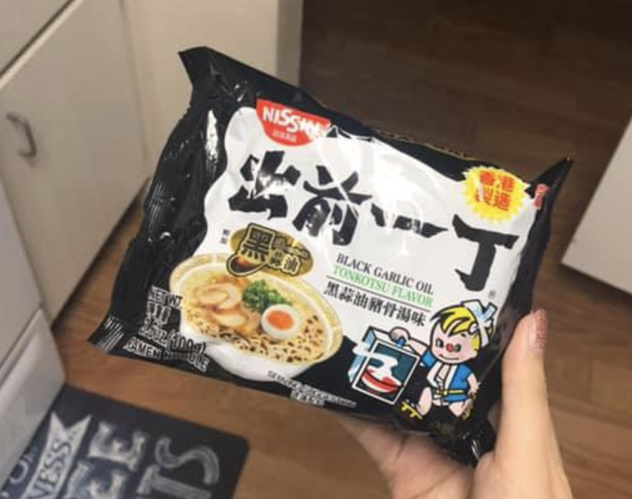
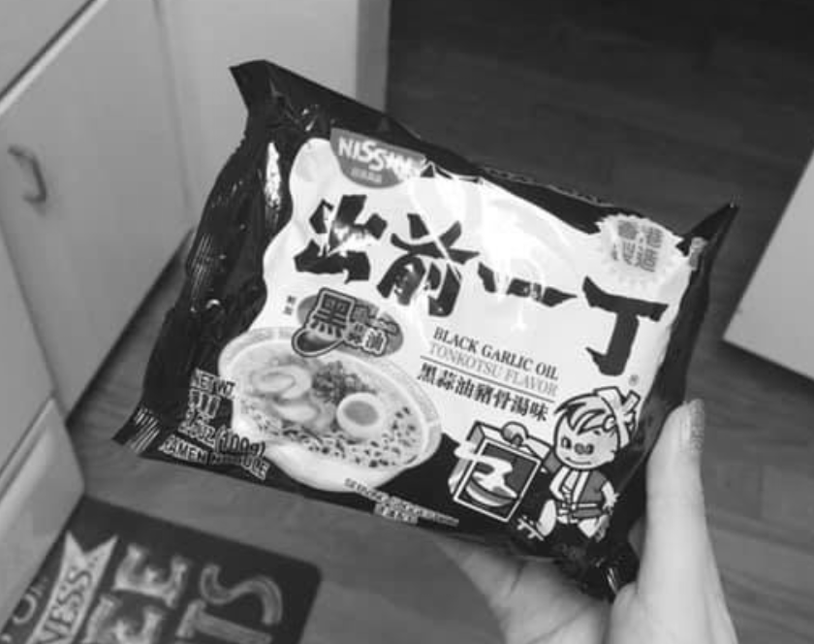
GRAYSCALE
Using a python script I processed an image of a ramen packet to black/white using the grayscale method
The grayscale uses RGB values to determine the corresponding combination for the grayscale

Slide 10
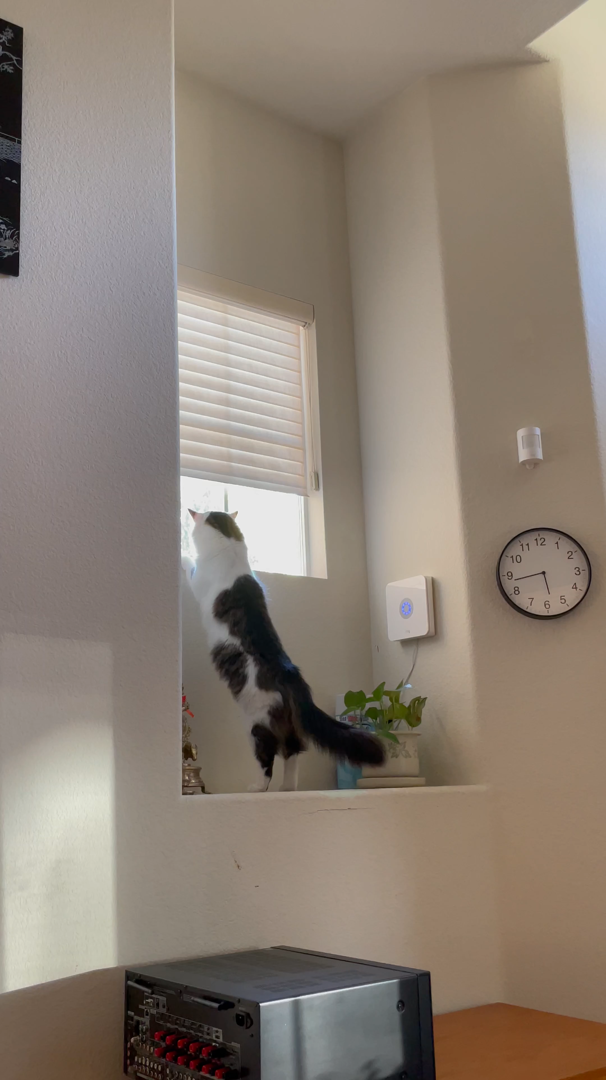
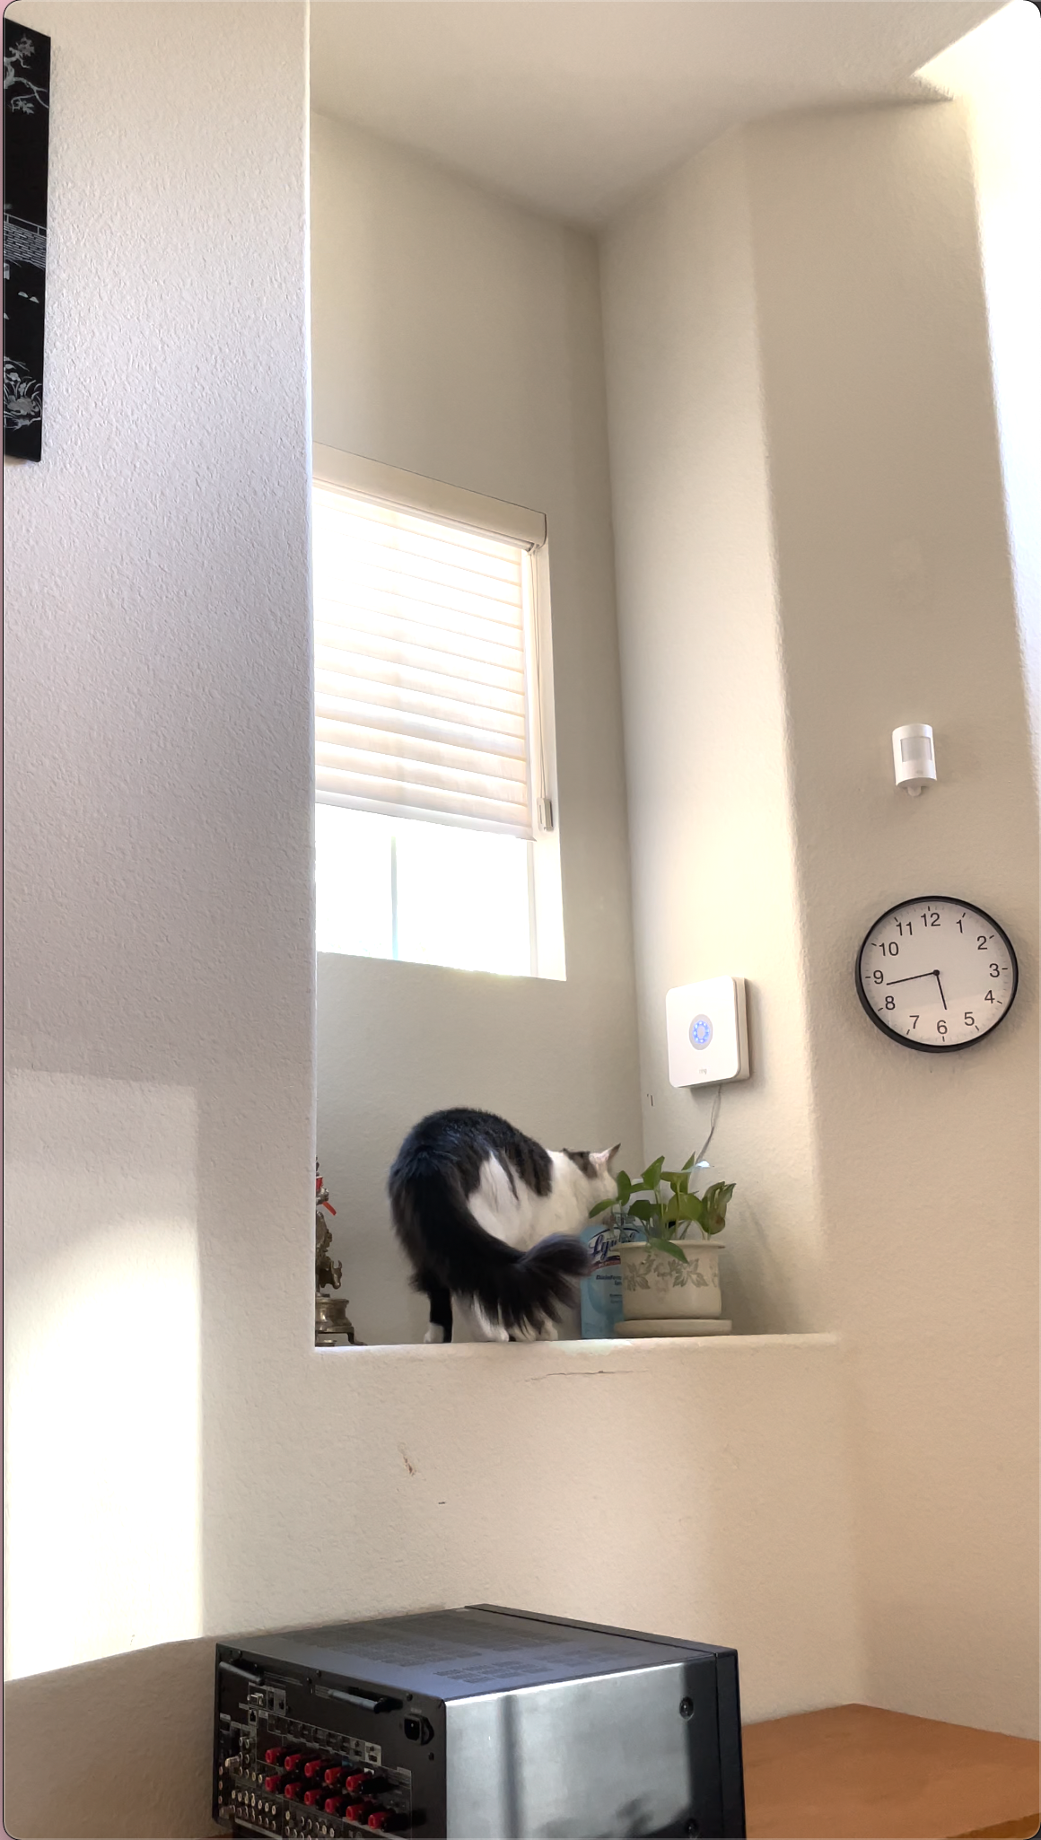
VIDEO
Using a python script I processed a video of my cat’s movement using a variety of methods

Slide 11
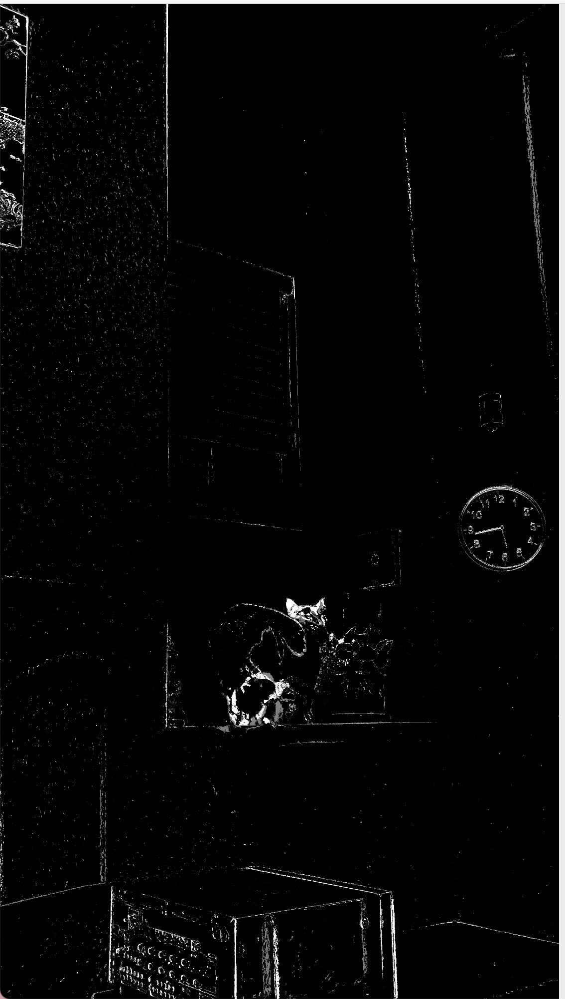
SUBTRACTION
An initial model of the background is computed and then the model is updated to adapt to possible changes in the scene.

Slide 12
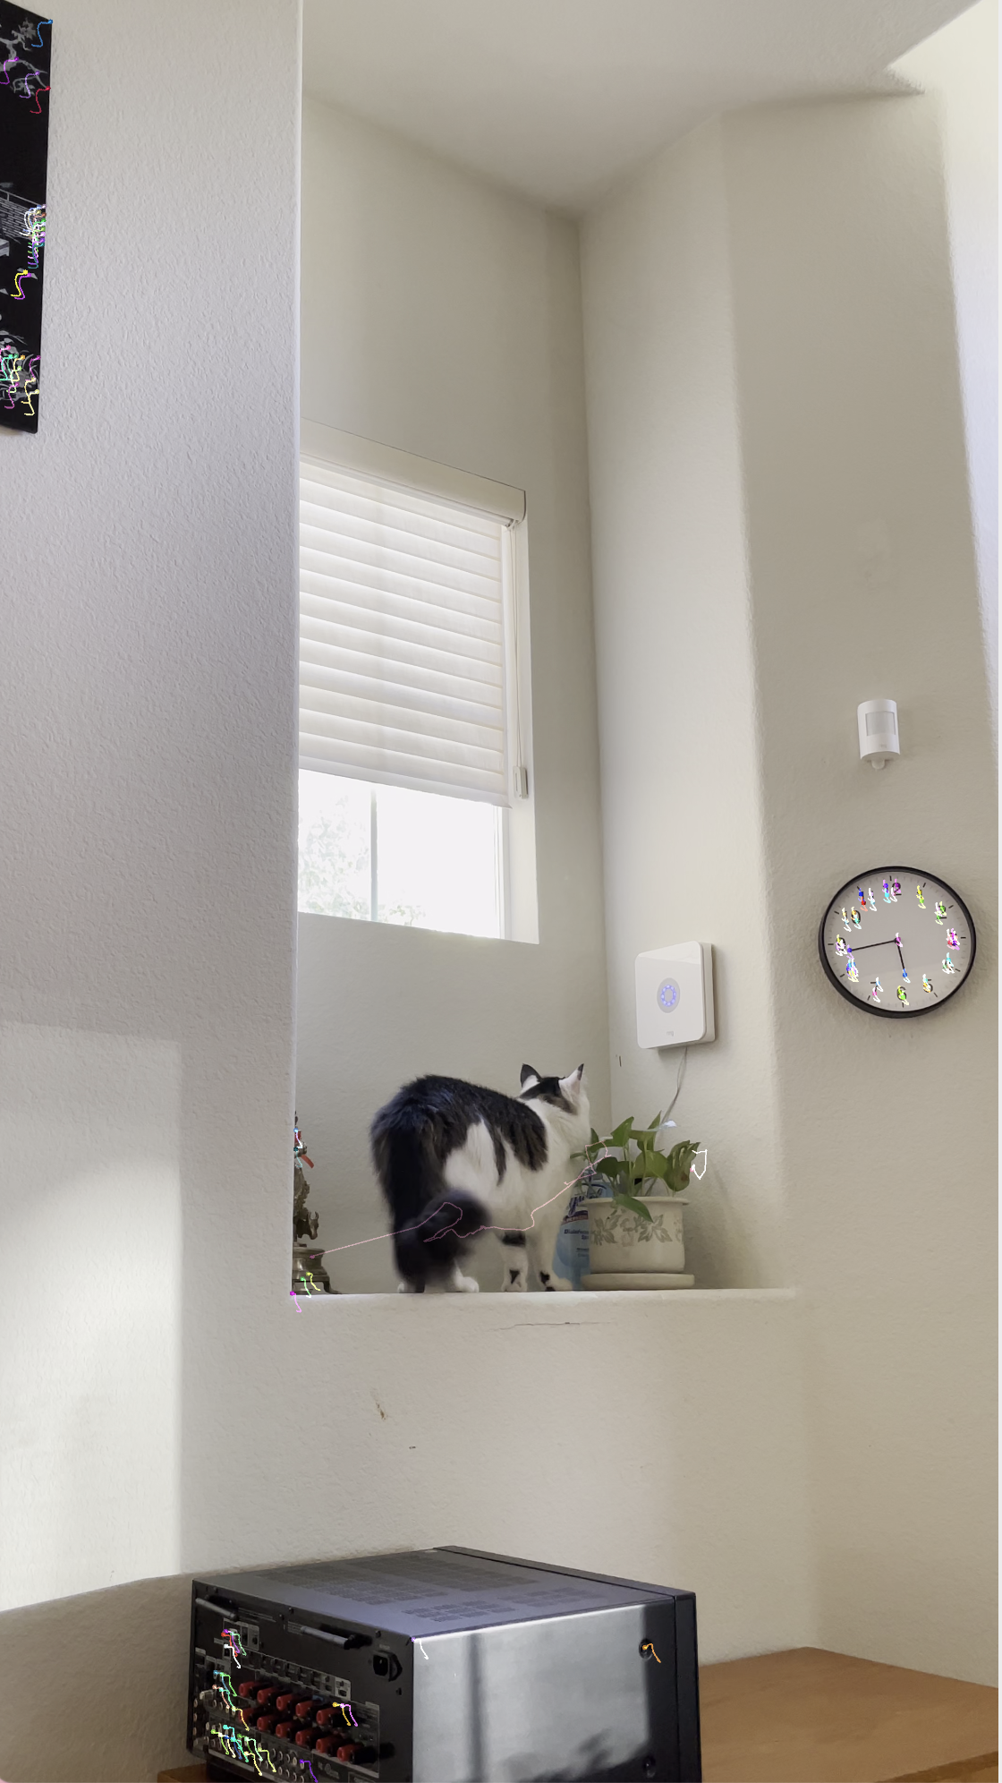
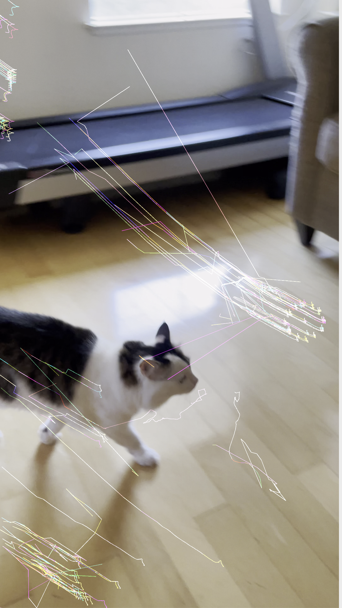
OPTICAL FLOW
Follows a pattern of image objects between consecutive frames caused by movement of the object or camera.
Lucas-Kanade Method uses a combination of optical flow vectors and pyramids for the movements

Slide 13
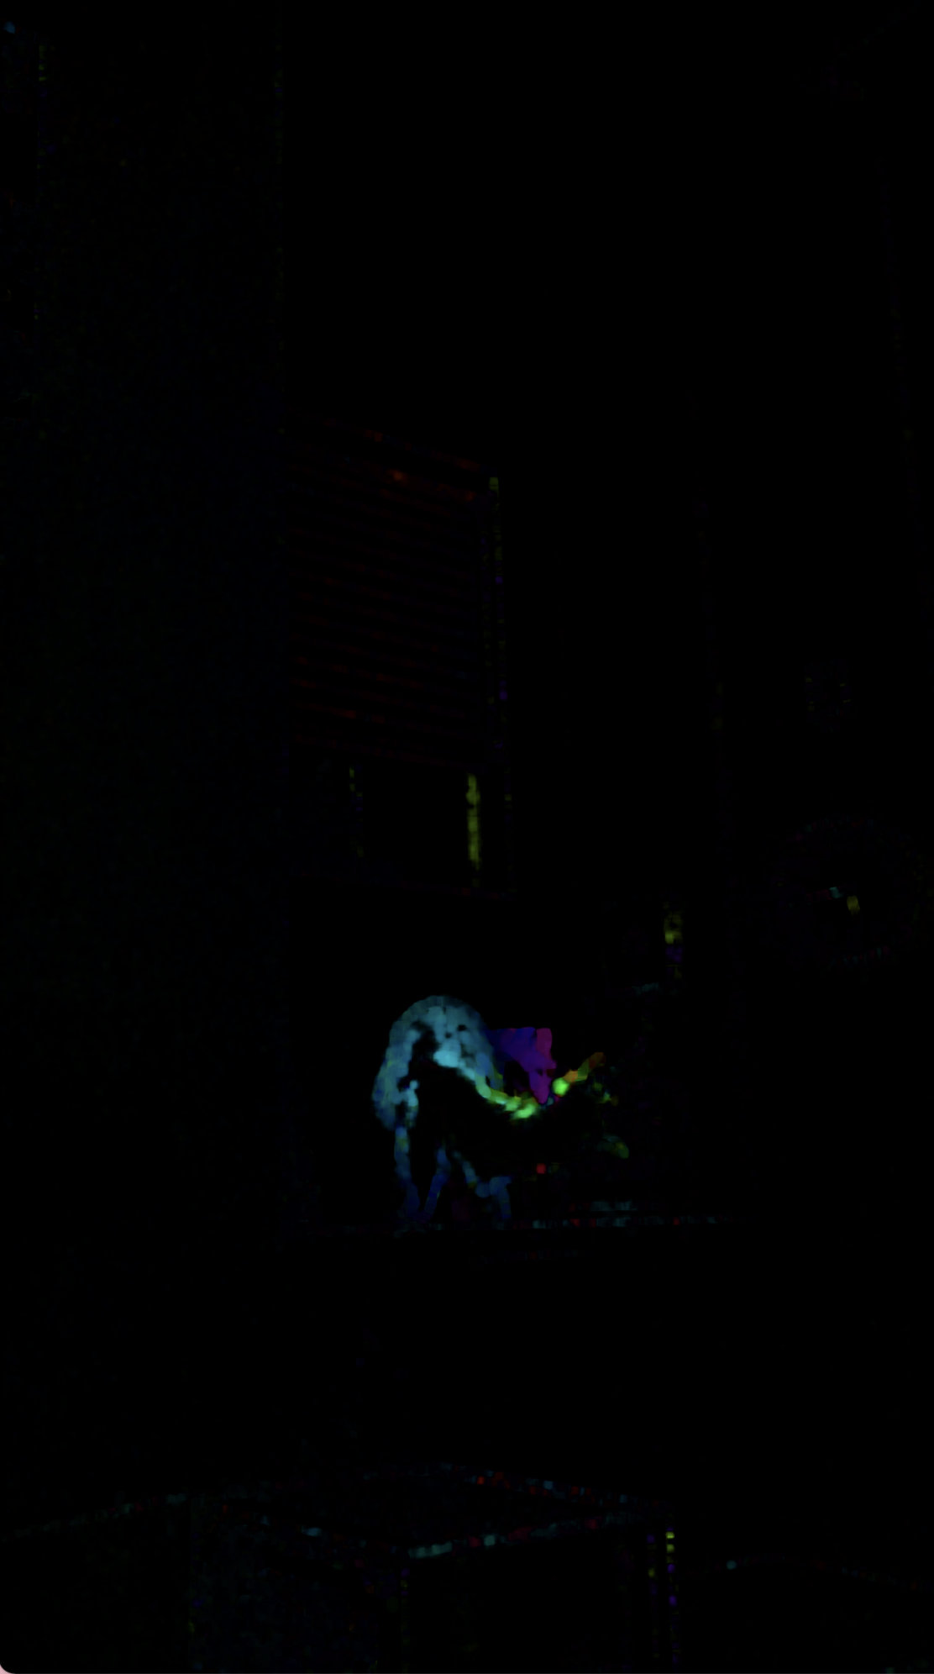
DENSE OPTICAL
Using a similar method by applying a 2-channel array with optical flow vectors to find magnitude and direction
Direction corresponds to the Hue and magnitude corresponds to the value

Slide 14
03
DEMO

Slide 15
04
APPLICATION

Slide 16
APPLICATION
Tracking Movement
Image Stability
Green Screen
CGI Movement
Animation
Traffic Cams
Filters (Image and Video)
Object Recognition

Slide 17
05
TECHNICAL

Slide 18
TECHNICAL
LANGUAGES
PACKAGES
SOURCE
APP.PY & SETUP
IMAGE_VIEW
HTML
Scripts available for C++ Python and Java
Opencv-python or
Opencv-contrib-python
https://docs.opencv.org/master/index.html
Import in the image_view.py where I had defined functions
Defined functions and would either open a separate window or save
Upload feature into the website that allows for image processing

Slide 19
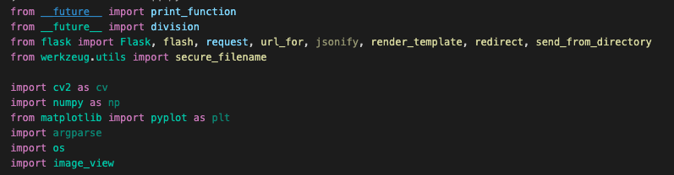
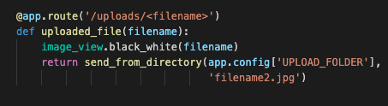
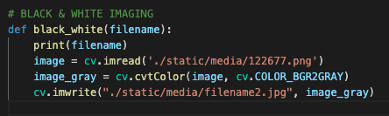
TECHNICAL

Slide 20
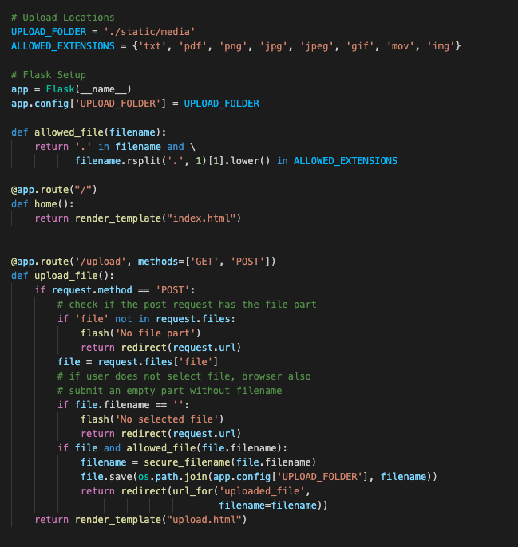
UPLOAD SETUP

Slide 21
05
QUESTIONS

Slide 22
THANKS!

